Slide 1












700
100
1600
200
100
750
Voice
400
Text to speech manager
450
Final Architecture
~4.5K lines of custom C# code compiled into a single .DLL
Configurability via properties retrieved to Neo4j
Logging library to Postgres via Postgrest API
Communications to Neo4j via rest call and custom JSON parsing
Graph library with visual DFS, BFS, Force Directed Graph, Heatmap and sizing based on properties
Interactivity via Gaze, Touch, Voice, and Text To Speech

Slide 2
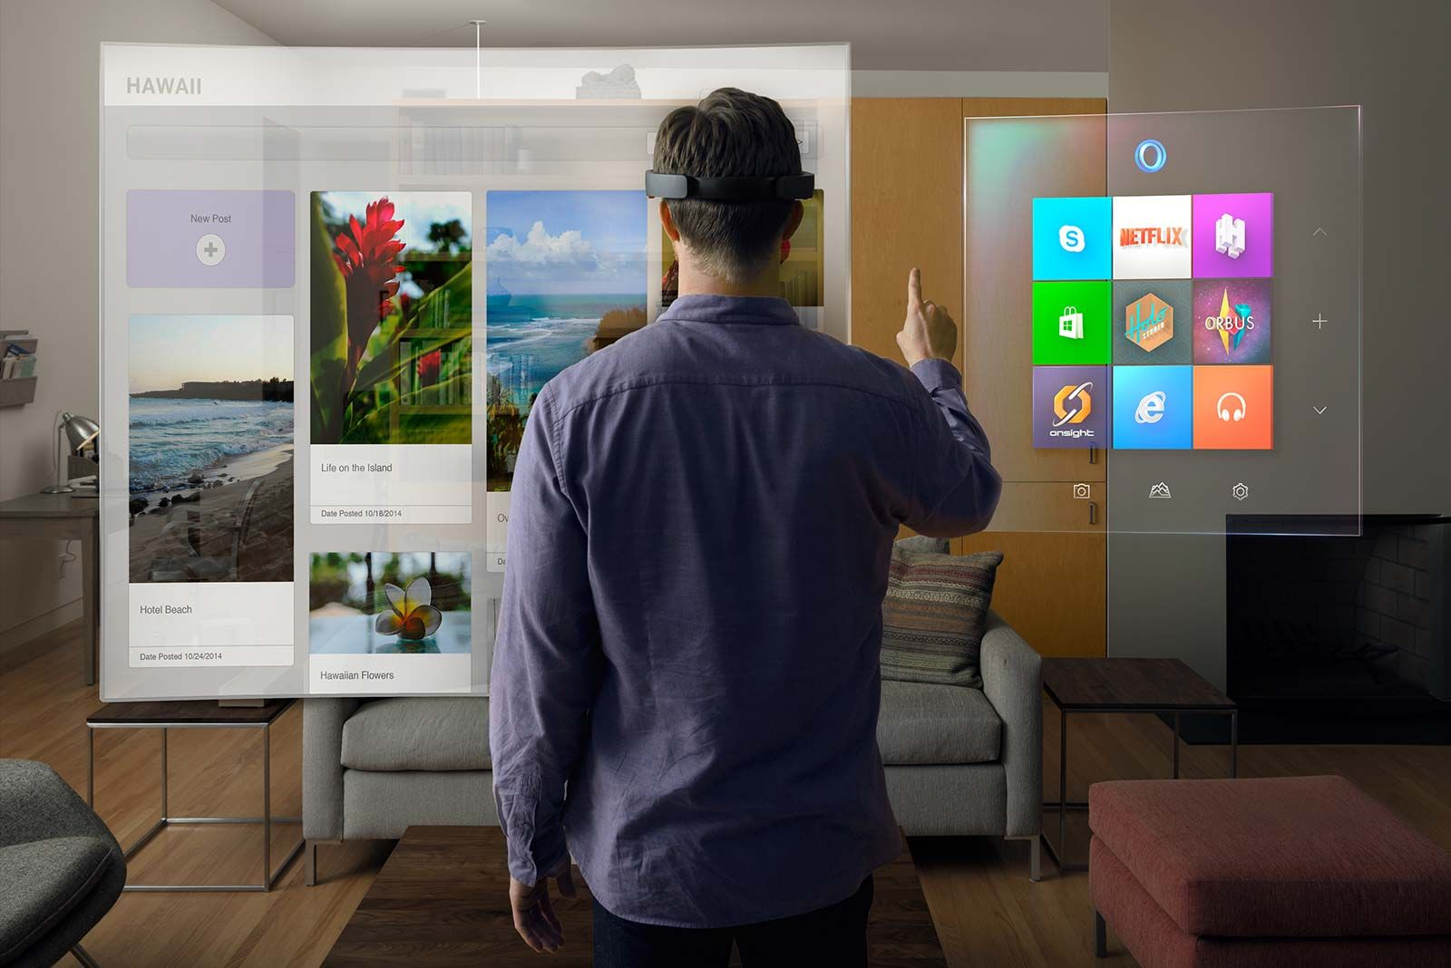
https://youtu.be/Oqs98R3rthI
https://youtu.be/rdQBloPMH_M

